Slide 1

Classification of Bank Marketing Dataset
Presented by
Rutuja A. Ugale

Slide 2

Contents
Introduction
Objective
Dataset
Features
Exploratory Data Analysis
Conclusion

Slide 3

Introduction
Problem Statement
Marketing Campaign Strategy Of International Bank
Target
Increase the number of marketing Campaigns
Economic pressure and Competition
Product promotion - Mass campaign - Directed Marketing
Reduction in cost and time
- Improvement in efficiency - Less Contacts ,More Success

Slide 4

Objective
Classify the potential customers - Capable of Subscribing to the Term Deposit Projected to them - Rules Based on some criteria or characteristics of customers

Slide 5


Dataset
Here I will be using the dataset of Bank Marketing Campaign to Predict the client will subscribe to a direct marketing. This dataset is based on the "Bank Marketing" UCI dataset (check the description at: http://archive.ics.uci.edu/ml/datasets/Bank+Marketing). It Contains information about the marketing campaign impact of a bank specifically through telemarkeng.it includes 20 independent variables of which 5 are the nationwide socio-economic factors pertaining to the banks operating country.

Slide 6
 |  | Variables
1. | Age | In years
2. | Job | type of job admin: "blue-collar" ,"entrepreneur", "housemaid" , "management" ,"retired", "self-employed" , "services" , "student" ,"technician" ,"unemployed", "unknown")
3. | Marital | marital status ("divorced", "married", "single", "unknown".
4. | Education | ("basic.4y","basic.6y","basic.9y","high.school","illiterate","professional.course","university.degree","unknown")
5. | Default | Does the customer have credit in default? ( "no", "yes" , "unknown")
6. | Balance | Balance of Individual
7. | Housing | Does the customer have a housing loan? ("no", "yes", "unknown")
8. | Loan | Does the customer have a personal loan? "no", "yes","unknown"

Slide 7
9. | Contact | contact communication type ("cellular", "telephone")
10. | Month | last contact month of year ("Jan", " Feb", "Mar", ..., "Nov", "Dec")
11. | Day-Of-Week | last contact day of the week ("Mon", "Tue", "Wed", "Thu", "Fri")
12. | Duration | last contact duration, in seconds.
13. | Campaign | Number of contacts performed during this campaign and for this client includes last contact
14. | pdays | Number of days that passed by after the client was last contacted from a previous campaign (999 means client was not previously contacted)
15. | Previous | number of contacts performed before this campaign and for this client
16. | poutcome | outcome of the previous marketing campaign (categorical: "failure" ,"nonexistent" ,"success")
17. | Y | has the client subscribed to a term deposit? ("yes", "no")

Slide 8

Problems
Missing Values
Outliers
Unbalanced Dataset

Slide 9
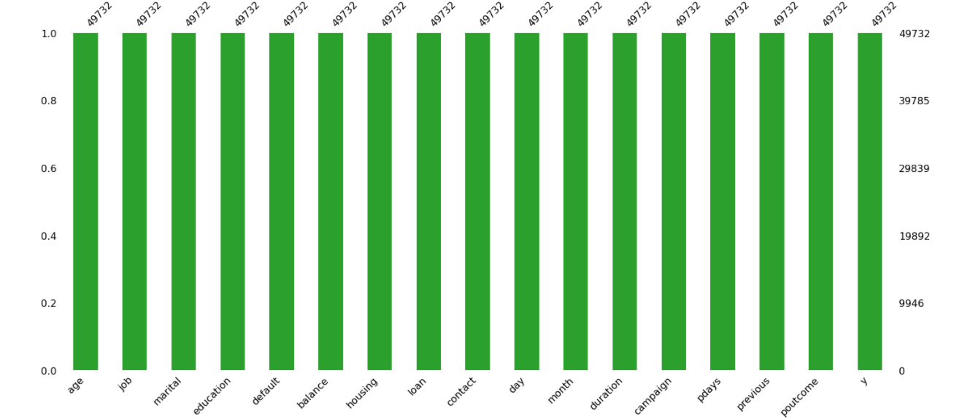
Missing Values
From Above Graph There is No Missing Values In This Dataset

Slide 10
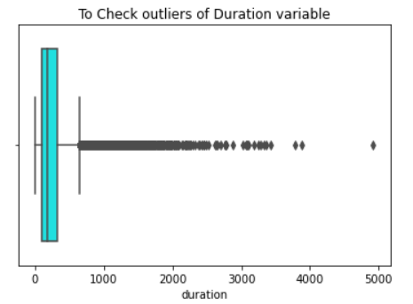
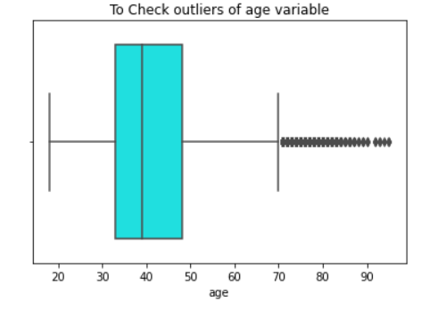
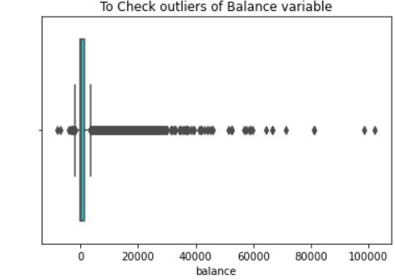
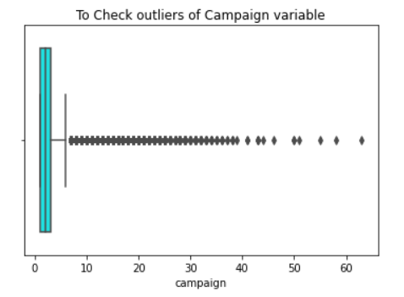
Outliers
From Above Figure We can see in this dataset there are many outliers.

Slide 11
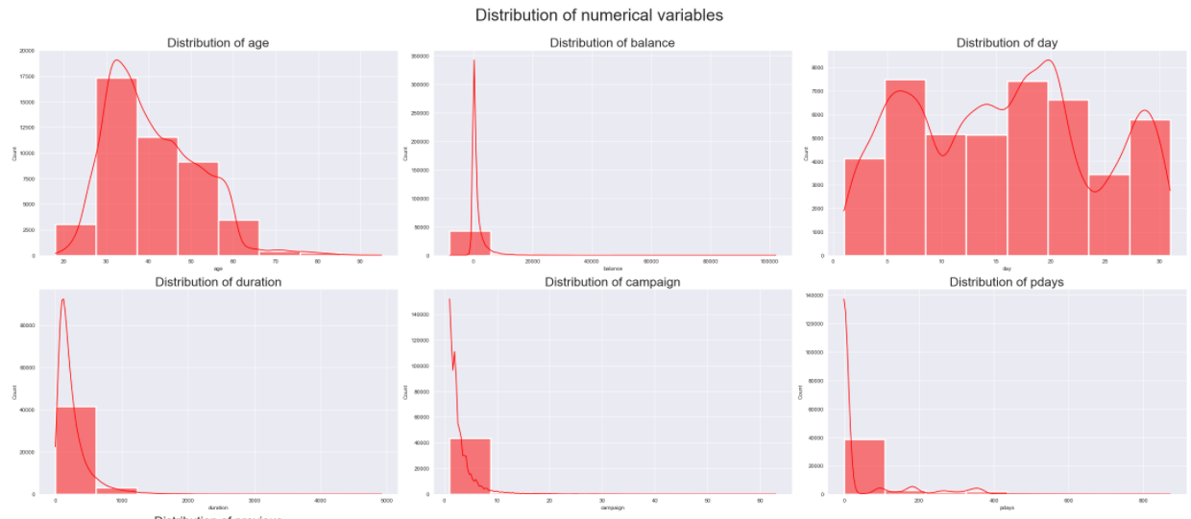
Skewness of data
From above figure We can see that Maximum Variables are right skewed

Slide 12
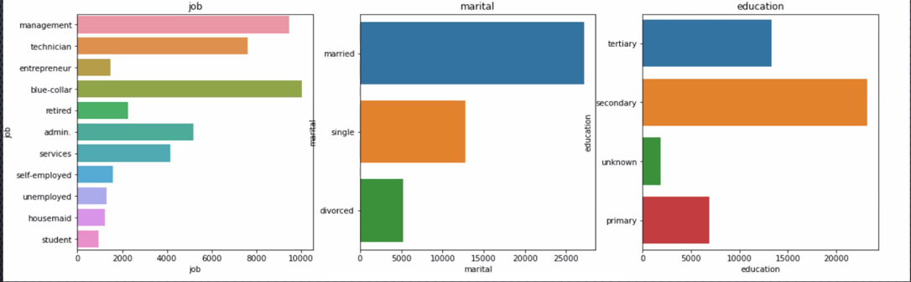
Distribution of Categorical variables
To see the distribution of categorical variable here I used the variable Job, Marital and Education.
The Job Type Blue-collar has maximum distribution as compare to the other job type.
Married people are maximum distributed as compare to divorced and single people.
The people whose take secondary education those are maximum distributed.

Slide 13

Conclusion
management client has high interest on deposit.
married client has high interest on deposit comparing to other client.
the client contacted by cellular method shows high interest in deposit.
During month may client shows high interest in deposit.
The client who has housing loan shows less interest in deposit.

Slide 14
Thank You

